Slide 1


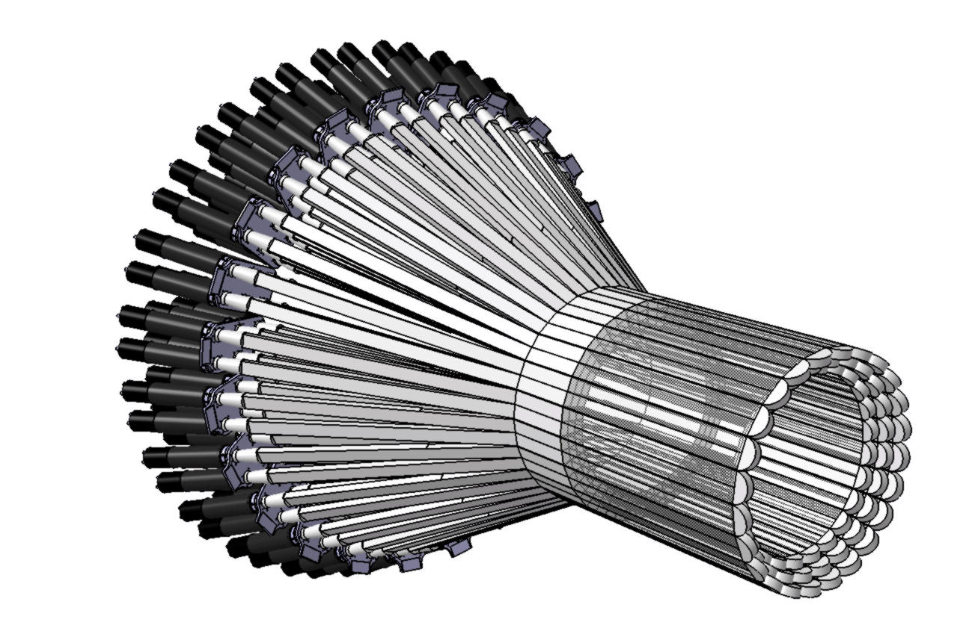





Deeply Virtual Compton Scattering on the neutron with CLAS12: a proposal for PAC37
Saclay
S. Niccolai, IPN Orsay
CLAS Collaboration meeting, 11/11/10

Slide 2
Letter of Intent presented to PAC34 (January 2009)
“LOI12-09-001: The PAC considers performing Deeply Virtual Compton Scattering on not only protons but also neutrons essential. For this a central neutron detector is required. This collaboration is strongly encouraged to complete the required R&D and bring forward a Proposal.”
Outline:
GPDs and nDVCS
Kinematics of nDVCS
Central Neutron Detector: requirements
Technical challenges
Ongoing R&D
Future work
Simulation: detector performances
Beam time request and expected results

Slide 3
Deeply Virtual Compton Scattering and GPDs
e’
Q²= - (e-e’)²
x_{B} = Q²/2Mν ν=E_{e}-E_{e’}
x+ξ, x-ξ longitudinal momentum fractions
t = (p-p’)²
ξ ≅ x_{B}/(2-x_{B})
e
t
γ
γ_{L}*
(Q²)
x+ξ
x-ξ
~
~
H, H, E, E (x,ξ,t)
conserve nucleon helicity
p
p’
~
Vector: H (x,ξ,t)
Tensor: E (x,ξ,t)
Axial-Vector: H (x,ξ,t)
Pseudoscalar: E (x,ξ,t)
~
« Handbag » factorization valid
in the Bjorken regime:
high Q² , ν (fixed x_{B}), t<<Q²
flip nucleon helicity
H(x,0,0) = q(x)
H(x,0,0) = Δq(x)
~
Quark angular momentum (Ji’s sum rule)
1
1
1
[
]
«3D» quark/gluon
image of
the nucleon
J
q
=
− J^{G} =
∫
xdx
H
q
(
x
,
ξ
,
0
)
+
E
q
(
x
,
ξ
,
0
)
2
2
−
1
X. Ji, Phy.Rev.Lett.78,610(1997)

Slide 4
Extracting GPDs from DVCS spin observables
γ
σ⁺ − σ⁻
σ⁺ + σ⁻
Δσ
2σ
ξ= x_{B}/(2-x_{B})
k=-t/4M²
A =
=
e’
φ
e
leptonic plane
Polarized beam, unpolarized proton target:
p’
~
hadronic
plane
Δσ_{LU} ~ sinφ Im{F₁H + ξ(F₁+F₂)H +kF₂E}dφ
~
H_{p}, H_{p}, E_{p}
Kinematically suppressed
Unpolarized beam, longitudinal proton target:
~
Measured
and/or planned
with CLAS
and CLAS12
~
H_{p}, H_{p}
Δσ_{UL} ~ sinφIm{F₁H+ξ(F₁+F₂)(H + … }dφ
Unpolarized beam, transverse proton target:
Δσ_{UT} ~ sinφIm{k(F₂H – F₁E) + ….. }dφ
H_{p}, E_{p}
Polarized beam, unpolarized neutron target:
~
~
H_{n}, H_{n}, E_{n}
Δσ_{LU} ~ sinφ Im{F₁H + ξ(F₁+F₂)H - kF₂E}dφ
Suppressed because F₁(t) is small
nDVCS gives access to E,
the least known and
least constrained GPD
that appears in Ji’s sum rule
Suppressed because of cancellation
between PPD’s of u and d quarks
H_{p}(ξ, ξ, t) = 4/9 H_{u}(ξ, ξ, t) + 1/9 H_{d}(ξ, ξ, t)
H_{n}(ξ, ξ, t) = 1/9 H_{u}(ξ, ξ, t) + 4/9 H_{d}(ξ, ξ, t)

Slide 5
Beam-spin asymmetry for DVCS: sensitivity to J_{u,d}
DVCS on the proton
J_{u}=.3, J_{d}=.1
J_{u}=.8, J_{d}=.1
J_{u}=.5, J_{d}=.1
J_{u}=.3, J_{d}=.8
J_{u}=.3, J_{d}=-.5
φ= 60°
x_{B} = 0.2
Q² = 2 GeV²
t = -0.2 GeV²
E_{e} = 11 GeV
VGG Model
(calculations
by M. Guidal)

Slide 6
Beam-spin asymmetry for DVCS: sensitivity to J_{u,d}
DVCS on the neutron
J_{u}=.3, J_{d}=.1
J_{u}=.8, J_{d}=.1
J_{u}=.5, J_{d}=.1
J_{u}=.3, J_{d}=.8
J_{u}=.3, J_{d}=-.5
The asymmetry for nDVCS is:
very sensitive to J_{u}, J_{d}
can be as big as for the proton
depending on the kinematics and on J_{u}, J_{d}
→ wide coverage needed
φ= 60°
x_{B} = 0.17
Q² = 2 GeV²
t = -0.4 GeV²
E_{e} = 11 GeV
VGG Model
(calculations
by M. Guidal)

Slide 7
nDVCS with CLAS12: kinematics
DVCS/Bethe-Heitler event generator
with Fermi motion, E_{e} = 11 GeV (Grenoble/Argonne)
Physics and CLAS12 acceptance cuts applied:
W > 2 GeV², Q² >1 GeV², –t < 1.2 GeV²
5° < θ_{e} < 40°, 2° < θ_{γ} < 40°
<p_{n}>~ 0.4 GeV/c
More than 80% of the neutrons have θ>40°
→ Neutron detector in the CD is needed!
Detected in
forward CLAS
Not detected
ed→e’nγ(p)
PID (n or γ?), p, angles
to identify the final state
Detected in
FEC, IC
CD
p^{μ}_{e} + p^{μ}_{n} + p^{μ}_{p} = p^{μ}_{e′} + p^{μ}_{n′} + p^{μ}_{p′} + p^{μ}_{γ}
In the hypothesis of absence of FSI:
p^{μ}_{p} = p^{μ}_{p’} → kinematics are complete
detecting e’, n (p,θ,φ), γ
FSI effects can be estimated measuring
enγ, epγ, edγ on deuteron in CLAS12
(same experiment)

Slide 8
Central Neutron Detector for nDVCS: requirements
Varying Δ(φ)
x200→+30%
Varying Δ(p)/p
x200→x40
nDVCS event generator with « smearing »
on neutron kinematic variables.
Effect of resolutions on MM(enγ):
Varying Δ(θ)
x200→+30%
little sensitivity to angular resolutions
stronger sensitivity to momentum resolution
Thanks to Baptiste Guegan

Slide 9
Central Neutron Detector for nDVCS: requirements
nDVCS event generator
+ electron and photon
resolutions obtained
from CLAS12 FastMC
+ design specs for
IC/Forward tagger
Photon resolution
contributes to 80%
of the width of MM
→ The CND must ensure:
good neutron identification for 0.2<pn<1.2 GeV/c → σ(TOF)~120 ps
for n/γ separation using β
momentum resolution below 10%
no stringent requirements for angular resolutions

Slide 10
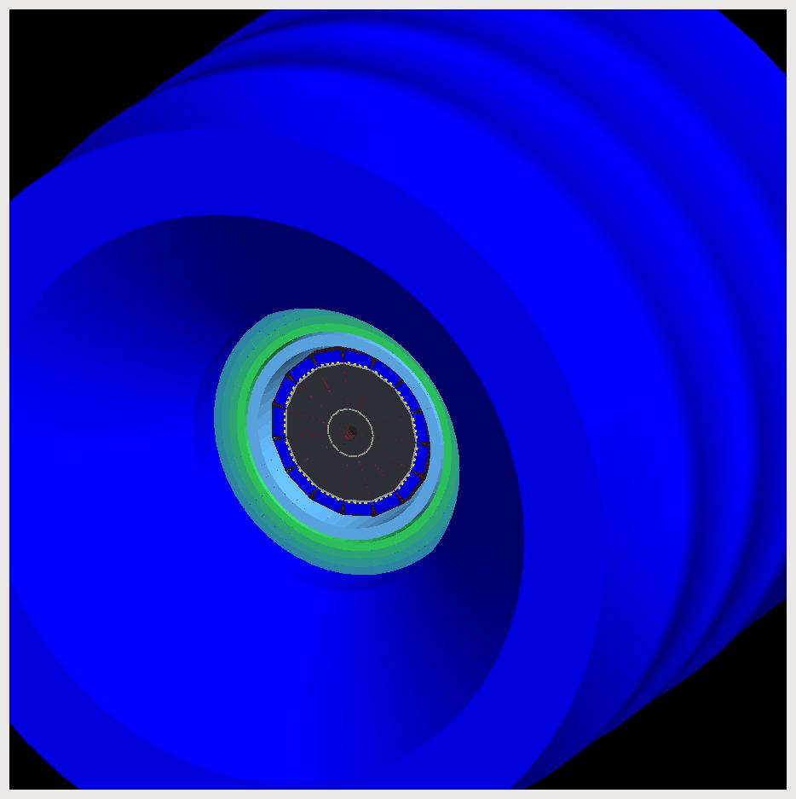
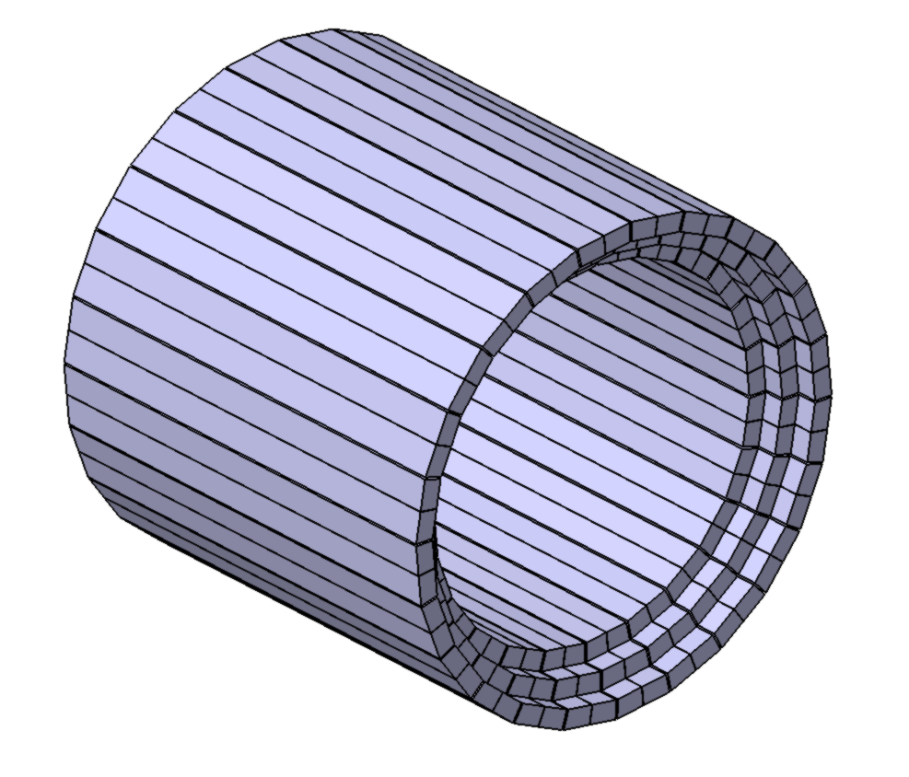
CND: constraints and early R&D results
limited space available (~10 cm thickness)
limited neutron detection efficiency
no space for light guides upstream
strong magnetic field (~5 T)
problems for light readout
CTOF can also be used for neutron detection
Central Tracker can work as a veto for charged particles
CTOF
Central
Tracker
CND
Detector type: scintillator barrel
3 radial layers, 48 bars per layer
Three kinds of B-field-resistant photodetectors
tested (timing measurement with cosmic rays):
SIPMs: too small active area → too few photons
APDs: too high time resolution (2 ns)
MCP-PMs: good time resolution but big loss of
gain in magnetic field of a few T
Matrices of SIPMs (Genova/Glasgow): promising, but
complex customized electronics needed

Slide 11
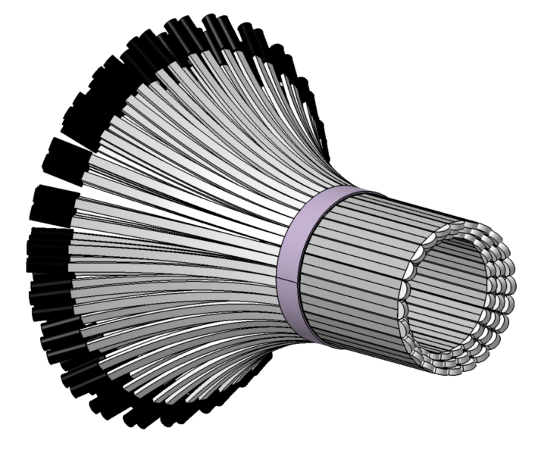
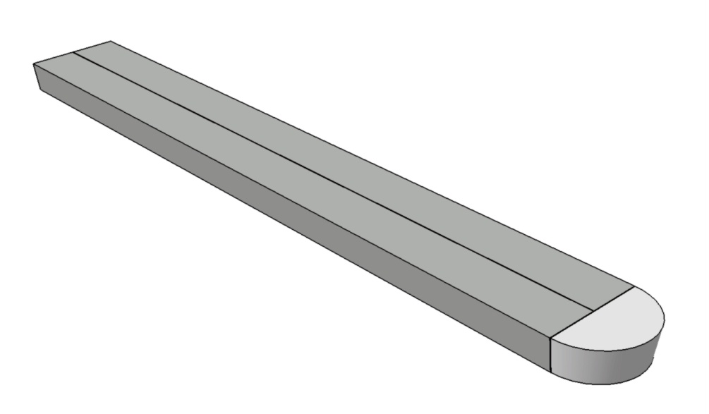
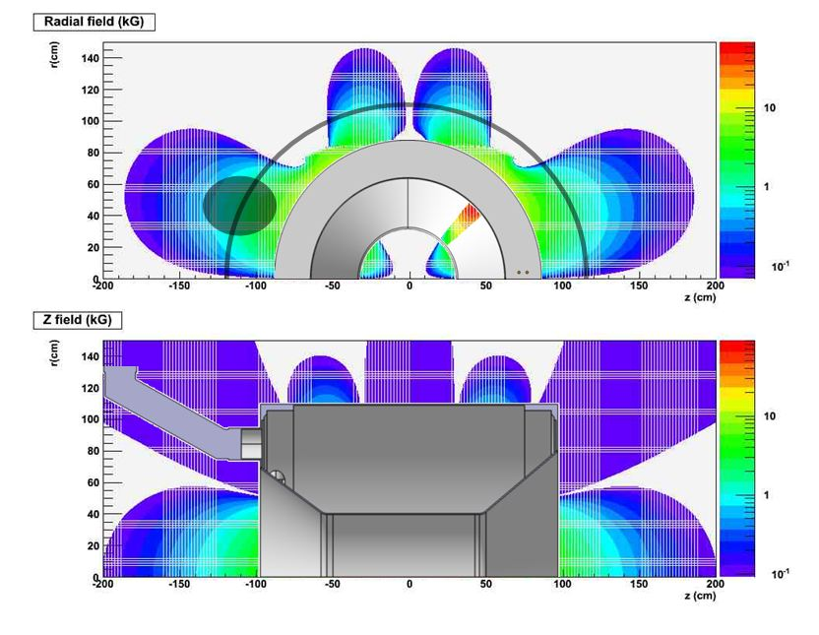
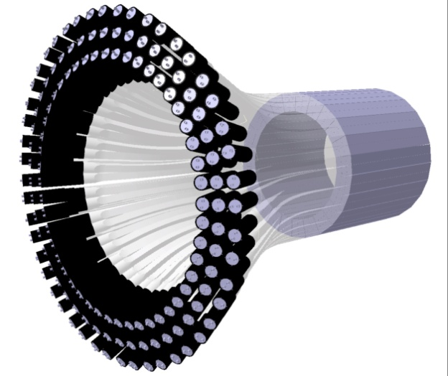
Current design: the “U – turn”
Two neighboring bars are connected via a semi-circular light guide
One of the two bars
acts as the « light guide » for the other one
PMTs location
The light comes out only from one side of the CND, goes through bent light guides (1.5m) arriving to PMTs, placed in the low-field region
Thanks to Julien Bettane, J. Pouthas, P. Rosier

Slide 12
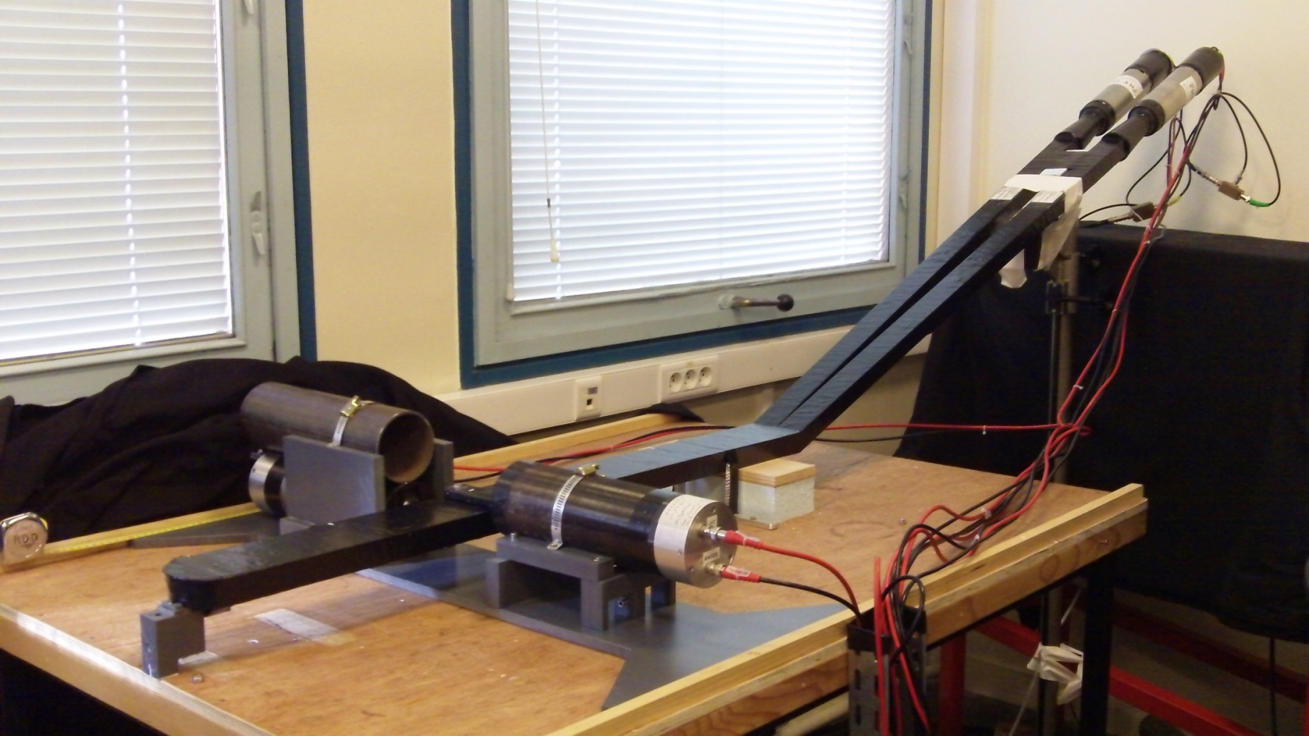
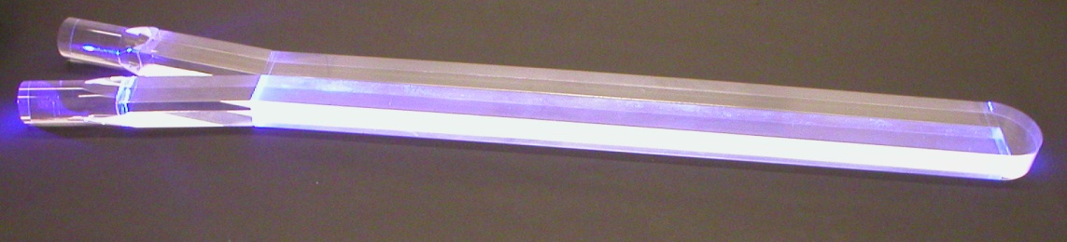
One-layer prototype
2 scintillators BC408 (700 mm long) coupled to two PMTs R2083 by means of 1500 mm long light guide, wrapping with Al foil, semicircular light guide at the “u-turn”
Thanks to Giulia Hull
Notes:
Then finally the single layer of the prototype.

Slide 13
One-layer prototype
2 scintillators BC408 (700 mm long) coupled to two PMTs R2083 by means of 1500 mm long light guide, wrapping with Al foil, semicircular light guide at the “u-turn”
-2 -1 0 1 2
X
PMT D
x
x
x
x
x
Light guide
Scintillator
Light guide
PMT N
D
A factor of 2 loss of light due to the u-turn
Thanks to Giulia Hull
Notes:
Clearly the light collection is considerably decreased with respect to the reference measurements due to the use of the long light guides.

Slide 14
One-layer prototype
2 scintillators BC408 (700 mm long) coupled to two PMTs R2083 by means of 1500 mm long light guide, wrapping with Al foil, semicircular light guide at the “u-turn”
D
N
PMT N
PMT D
TRG
PMT D ∈ [105, 136] ps
PMT N ∈ [194, 262] ps
Thanks to Giulia Hull

Slide 15
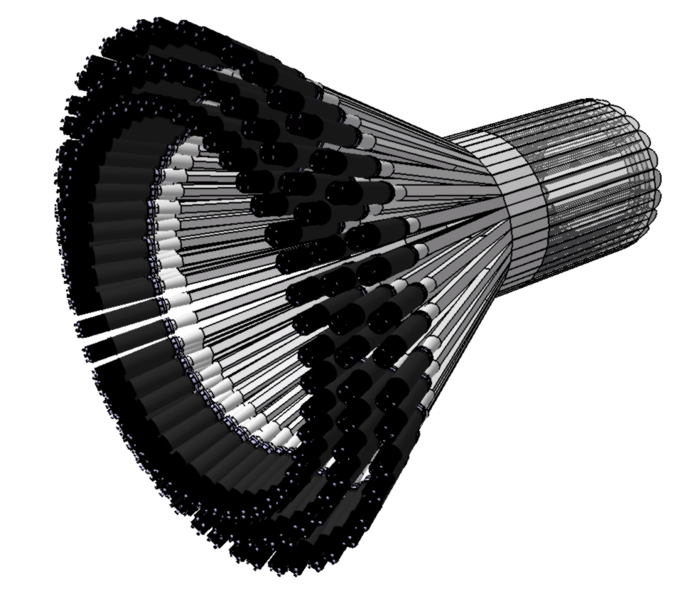
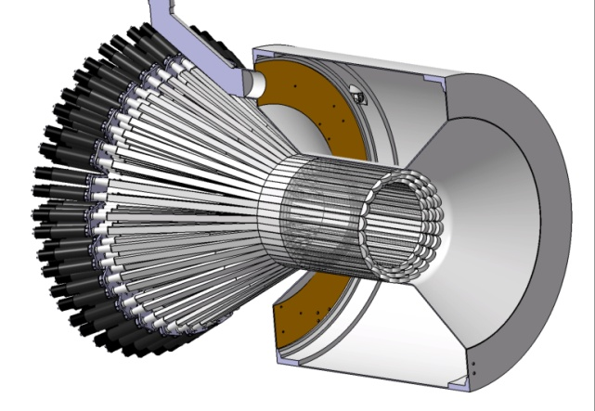
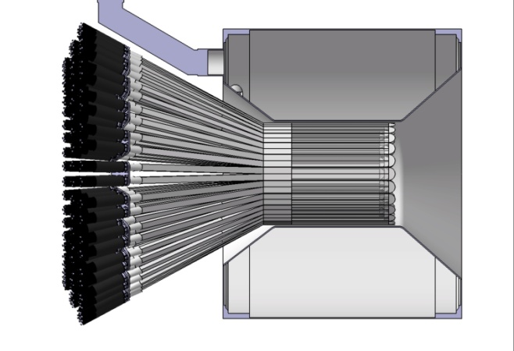
Mechanics and integration
Semicircular light guides
Scintillators
Light guide
PMTs

Slide 16
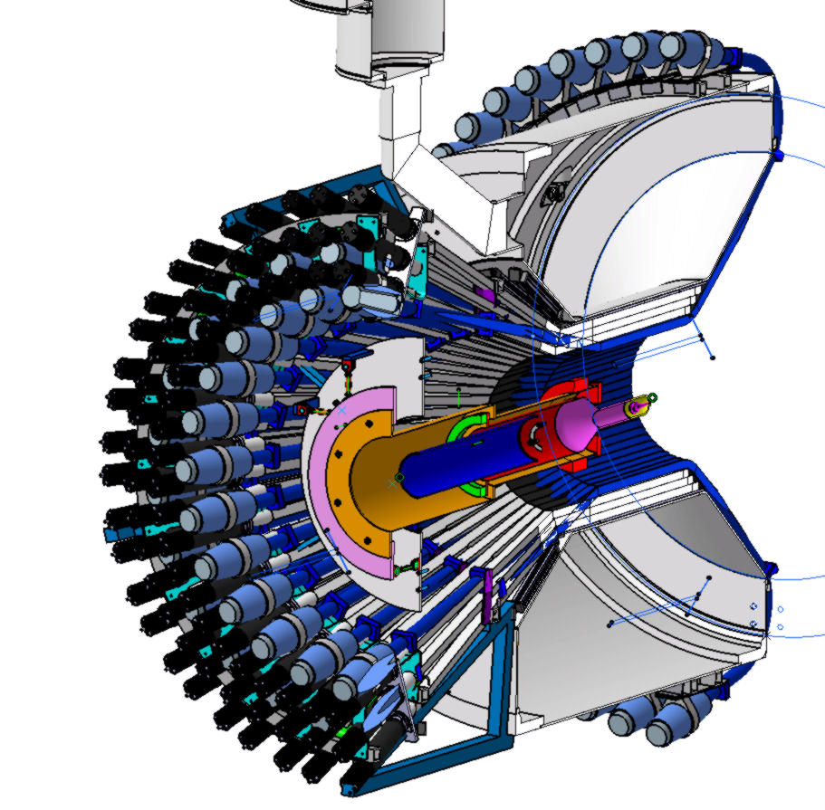
Mechanics and integration

Slide 17
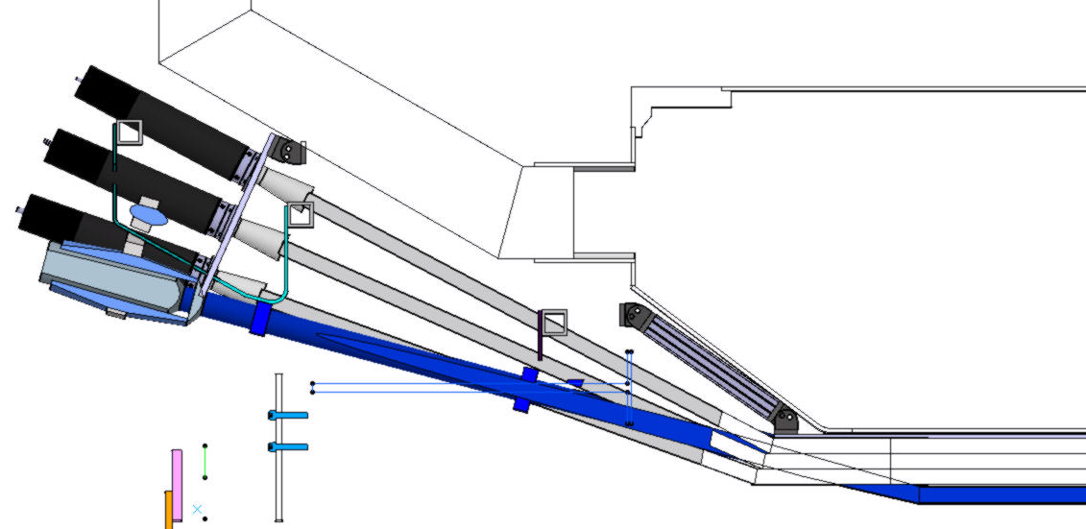
Mechanics and integration
Meeting - Nov 09 2010

Slide 18
Mechanics and integration
Meeting - Nov 09 2010
Keeping volume
Mechanic structure through the CND
PMTs position according to the magnetic field

Slide 19
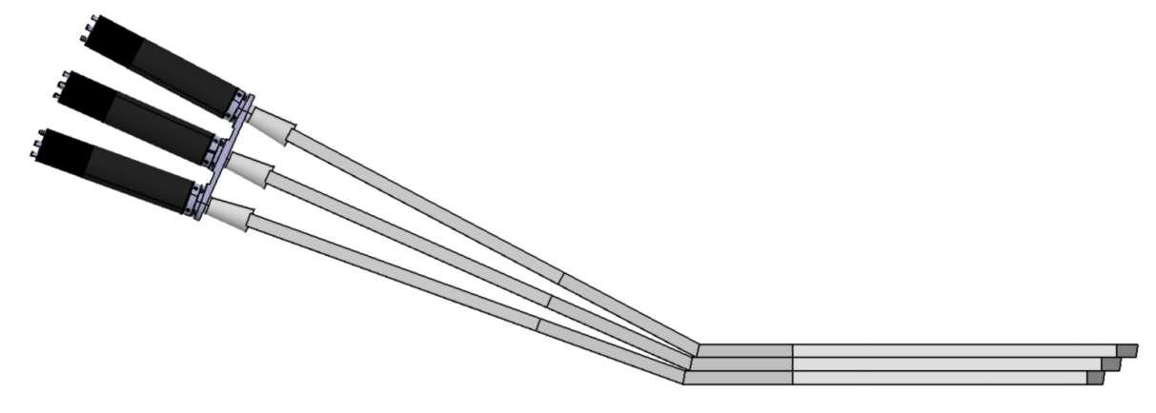
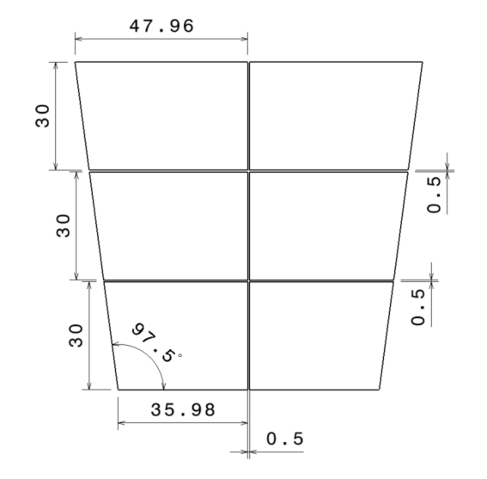
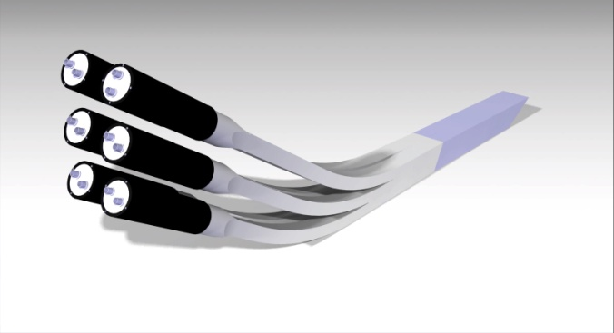
Work plan for the next months
Test of the one-layer prototype with PMT R9779 (1/3 of the price of R2083)
Test of the prototype with 6 PMTs, 6 scintillators
Optimize length of light guides, PMT shieldings according to up-to-date B-field map

Slide 20
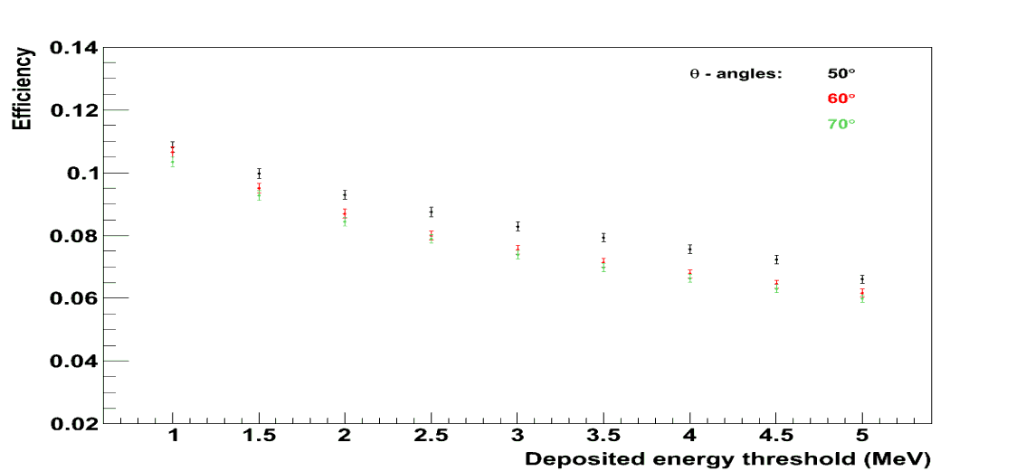
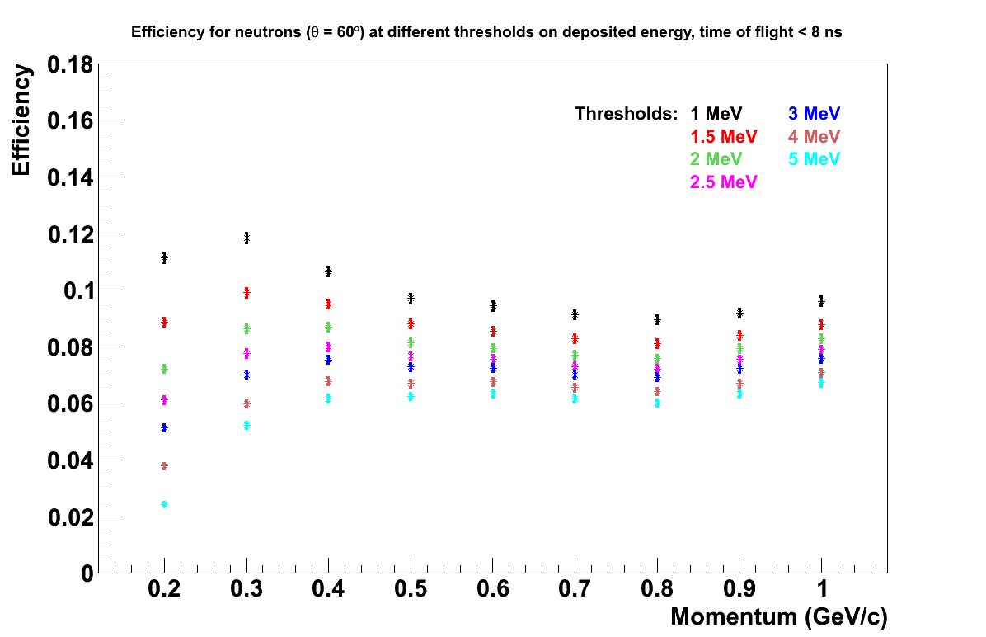
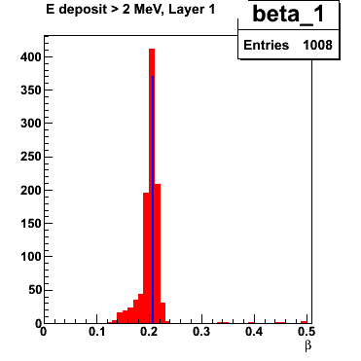
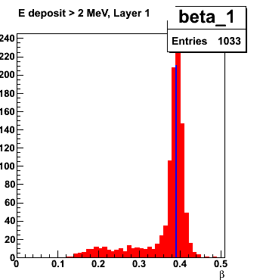
CND: simulations
Thanks to Daria Sokhan
Full Gemc simulations (all CD) done for:
efficiency
PID (neutron/photon separation)
momentum and angular resolutions
tests of reconstruction algorithms
background studies
Measured values of σ(TOF) and energy loss
due to u-turn implemented
pn = 0.4 GeV/c
Efficiency ~ 8-10%
for a threshold of 2 MeV, TOF<8 ns
and p_{n} = 0.2 - 1 GeV/c
0.2 GeV/c
L
PMT-N
0.4 GeV/c
PMT-D
z_{D}

Slide 21
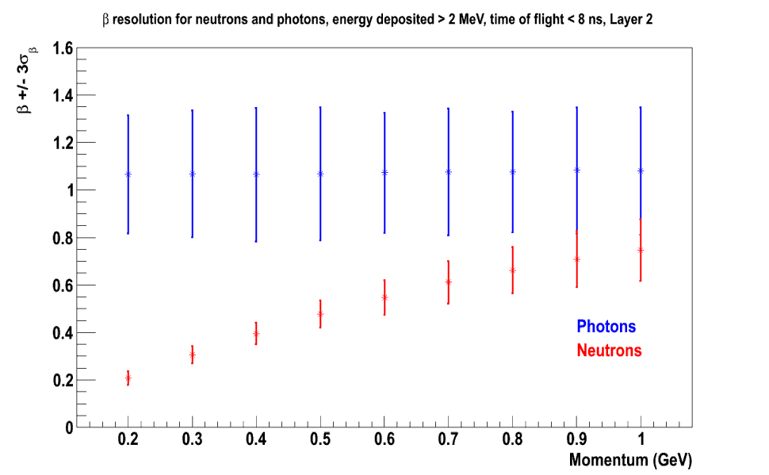
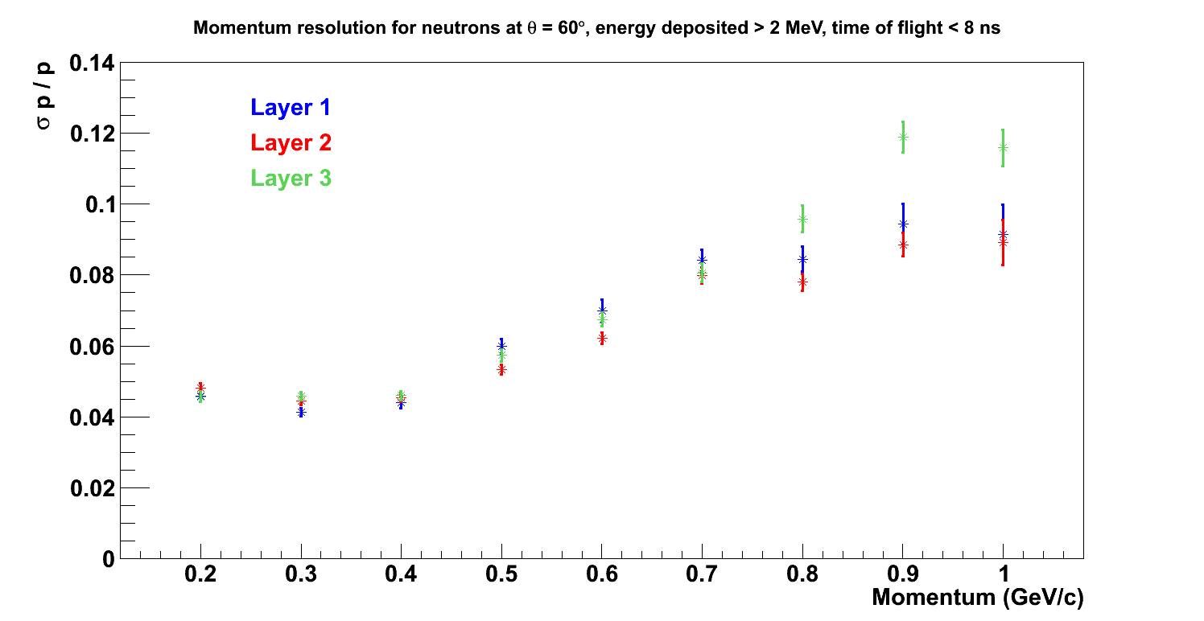
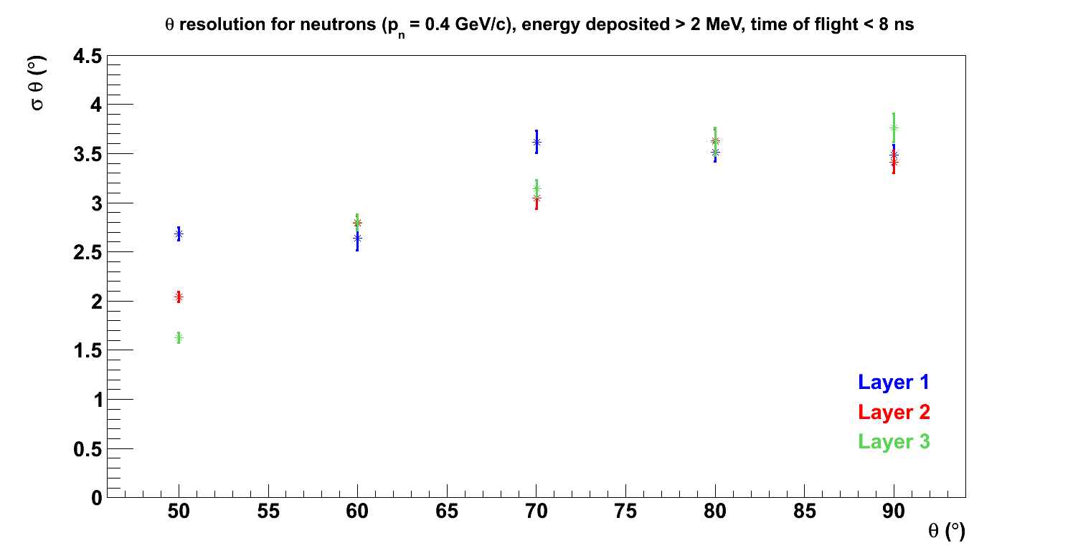
CND: simulations
Thanks to Daria Sokhan
n/γ misidentification
for p_{n} ≥ 1 GeV/c
Error bars on the β - axis represent 3 σ
Equal n/γ yields assumed
β
Δp/p ~ 4-10%
Δθ ~ 2-4°

Slide 22
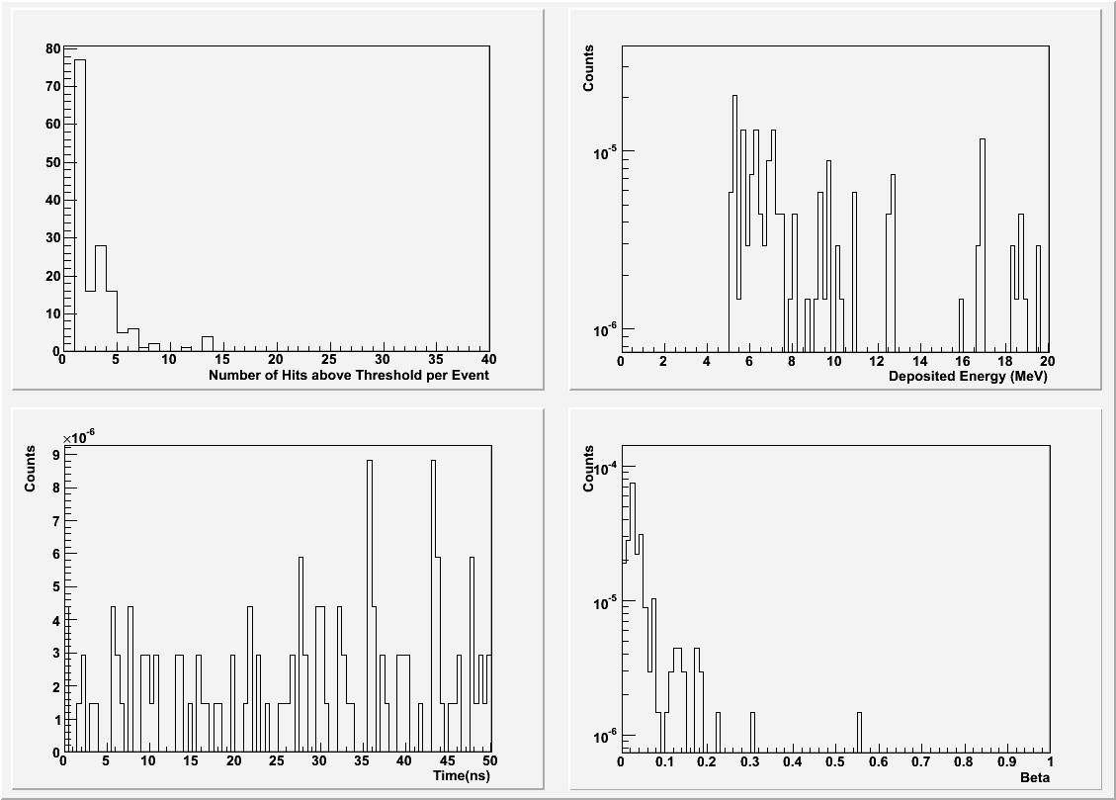
Backgrounds
Electromagnetic background rates and spectra for the
CND have been studied with Gemc:
The background on the CND produced by the beam
through electromagnetic interaction in the target
consists of neutrals (most likely photons)
Total rate ~2 GHz at luminosity of 10³⁵ cm⁻²·s⁻¹
Maximum rate on a single paddle ~ 22 MHz
This background can be reconstructed as a neutron:
with a 5 MeV energy threshold the rate is ~ 3 KHz
For these “fake” neutrons β<0.1-0.2 → p_{n} < 0.2 GeV/c
β, for Edep>5 MeV
Physical background from photons coming from asymmetric meson decays have been studied with CLASDIS:
requiring an electron and a photon (Eγ>1 GeV) in the FD
applying “DVCS-like” cut MM(eγ)<1.1 GeV
assuming 30% of acceptance + efficiency for electron and photon → 2 Hz of photon rate on the CND (comparable to nDVCS neutrons rate ~ few Hz)
Realistic FD & CND
resolutions
and acceptances
Thanks to Raffaella De Vita
Comparison nDVCS/enπ⁰(p)
« DVCS cuts » → 5-10% contamination

Slide 23
nDVCS with CLAS12 + CND: beam time request
Beam-spin asymmetry for nDVCS
N = ∆t ∆Q² ∆x ∆φ L Time R_{acc} E_{eff}
VGG prediction for
Ju=.3, Jd=.1
L = 10³⁵cm⁻²s⁻¹
Time = 80 days (to be optimized)
R_{acc}= bin-by-bin acceptance (16%-35%)
E_{eff} = neutron detector efficiency (~10%, only CND included at this stage)
<t> ≈ -0.5 GeV²
<Q²> ≈ 2.2GeV²
<x> ≈ 0.13
Count rates computed with nDVCS+BH
event generator
+ CLAS12 acceptance from FastMC
+ CND efficiency from Gemc simulation
Δt = 0.4 GeV² ΔQ² =1.5 GeV²
Δx_{B} = 0.15 Δφ = 30° (bin sizes to be optimized)
nDVCS cross section will also be measured
Thanks to Baptiste Guegan
& Michel Guidal

Slide 24
Conclusions
nDVCS is a key reaction for the GPD experimental program: measuring its beam-spin asymmetry can give access to E and therefore to the quark orbital angular momentum
(via the Ji’s sum rule)
A large kinematical coverage is necessary to sample the phase-space, as the BSA is expected to vary strongly → CLAS12 at upgraded JLab is the ideal facility
The detection of the recoil neutron is very important to ensure exclusivity, reduce
background and keep systematic uncertainties under control
The nDVCS recoil neutrons are mostly going at large angles (θ_{n}>40°), therefore a
neutron detector should be added to the CLAS12 Central Detector, using the available space
The Central Neutron Detector will fit between CTOF and the solenoid. The CTOF can also
be used to detect the neutrons (+3% of efficiency). The central tracker will serve as a veto
for charged particles
Using scintillator as detector material and our design (u-turn downstream and long light guides with PMTs upstream) detection of nDVCS recoil neutrons with ~10% of efficiency and n/γ separation for p ≤ 1 GeV/c can be achieved
A draft of the proposal is available, review committee appointed (P. Stoler, I. Niculescu).
Work ongoing on count-rate estimates, optimization of binning.

Slide 25
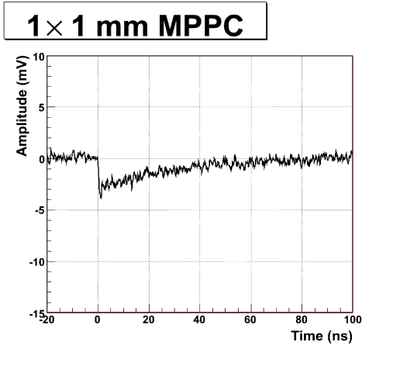
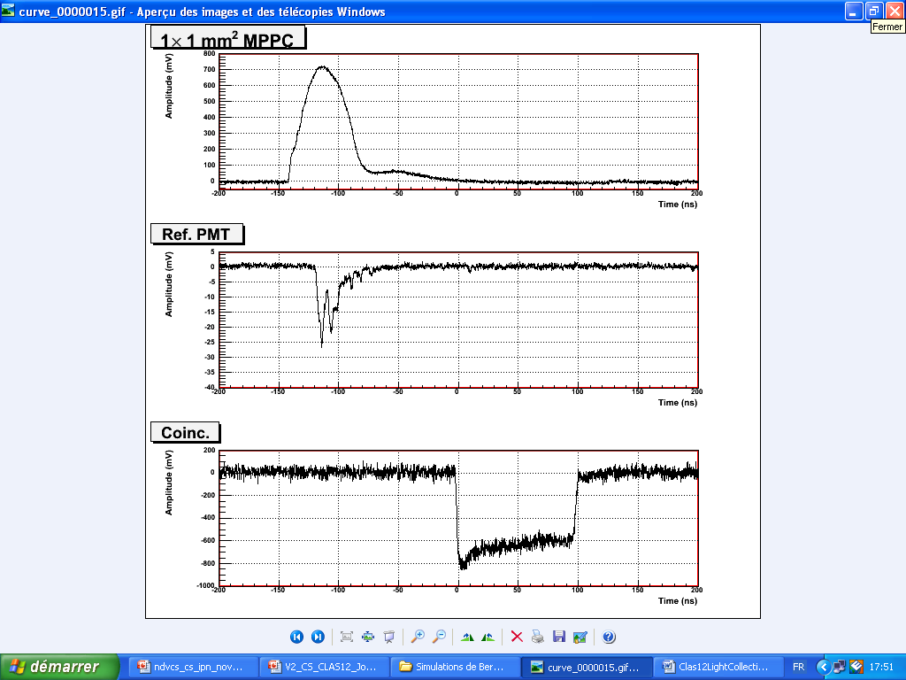
Results from Orsay’s test bench
Thi Nguyen Trung
Bernard Genolini
S. Pisano
J. Pouthas
Ref
Test
σ²_{test} =1/2 (σ²_{test,trig} + σ²_{test,ref} − σ²_{ref,trig})
Trig
Test = 1 SiPM Hamamatsu
(MPPC 3x3mm²)
rise time ~5 ns
(> capacitance)
more noise than 1x1 mm²
Test = PMT
σ_{TOF} < 90 ps
nphe ~1600
Single pe
Test = 1 SiPM Hamamatsu
(MPPC 1x1 mm²)
σ_{TOF} ~ 1.8 ns
rise time ~ 1 ns
nphe ~1
Test = 1 APD Hamamatsu
(10x10 mm² )
σ_{TOF} ~ 1.4 ns
high noise, high rise time
Test = 1 MPPC 1x1mm²
Extruded scint. + WLS fiber
σ_{TOF} ~ 1.4 ns
WLS -> Width ~ 15 ns
Test = 1 MCP-PMT
Photonis/DEP (two MCPs)
σ_{TOF} ~ 130 ps
will be tested in B field
at Saclay (end of November)
Notes:
25

Slide 26
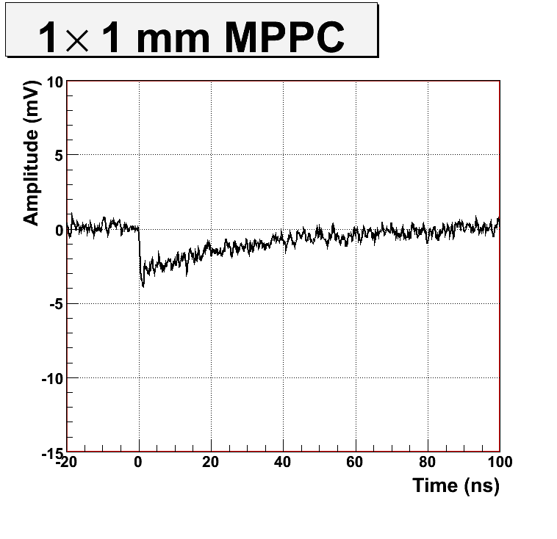
Results from Orsay’s test bench
Thi Nguyen Trung
Bernard Genolini
S. Pisano
J. Pouthas
Ref
Test
σ²_{test} =1/2 (σ²_{test,trig} + σ²_{test,ref} − σ²_{ref,trig})
Trig
Single pe
test = PMT:
σ_{TOF} < 90 ps
nphe ~1600
test = 1 SiPM Hamamatsu
MPPC 3x3mm²:
rise time ~5 ns (> capacitance)
more noise than 1x1 mm²
test = 1 MCP-PMT Photonis
double-plate:
σ_{TOF} ~ 105 ps
will be tested in B field at Saclay
(end of November)
simulations underway for lifetime
test = 1 SiPM Hamamatsu
MPPC 1x1 mm²:
σ_{TOF} ~ 1.8 ns
rise time ~ 1 ns
nphe ~1
test = 1 APD Hamamatsu
10x10 mm² + IC preamp:
σ_{TOF} ~ 1.4 ns
high noise, high rise time
Ongoing: tests with extruded
scintillator + WLS fibres +SiPM

Slide 27
First measurement of nDVCS: Hall A
M. Mazouz et al., PRL 99 (2007) 242501
E_{e}= 5.75 GeV/c P_{e} = 75 %
L = 4 ·10³⁷ cm⁻² · s⁻¹/nucleon
e’
HRS
e
LH₂ / LD₂ target
γ
Electromagnetic Calorimeter (PbF₂)
Analysis done in the impulse approximation:
Active nucleon identified
via missing mass
Q² = 1.9 GeV²
x_{B} = 0.36
0.1 GeV² < -t < 0.5 GeV²
Subtraction of quasi-elastic proton contribution deduced from H₂ data convoluted with initial motion of the nucleon
Twist-2

Slide 28
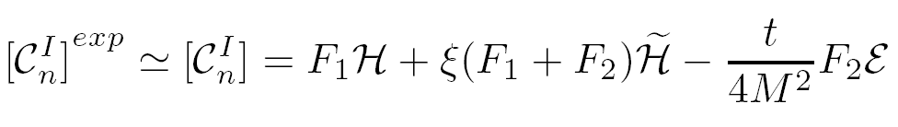
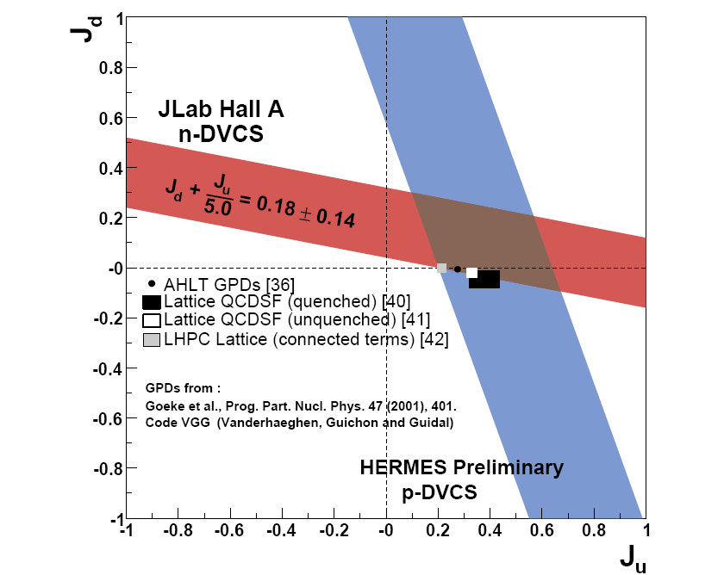
nDVCS in Hall A: results
M. Mazouz et al., PRL 99 (2007) 242501
Q² = 1.9 GeV² - x_{B} = 0.36
F. Cano, B. Pire, Eur. Phys. J. A19 (2004) 423
Model dependent
extraction of J_{u} and J_{d}
S. Ahmad et al., PR D75 (2007) 094003
VGG, PR D60 (1999) 094017
Im(C^{I}_{n}) compatible with zero (→ too high x_{B}?)
Strong correlation between Im[C^{I}_{d}] and Im[C^{I}_{n}]
Big statistical and systematic uncertainties
(mostly coming from H² and π⁰ subtraction)

Slide 29
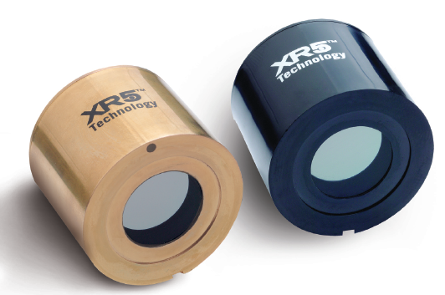
Technical challenge: TOF resolution & B=5T
SiPM - PROS:
Insensitive to magnetic field
High gain (10⁶)
Good intrinsic timing resolution (30 ps/pixel)
Good single photoelectron resolution
SiPM
MCP-PMT
SiPM - CONS:
Very small active surface (1-3 mm²)
→ small amount of light collected (σ_{TOF}~1/√N_{phel})
Noise
MCP-PMT
APD – PROS:
insensitive to magnetic field
bigger surface than SiPM → more light collected
APD – CONS:
low gain at room temperature
timing resolution?
MCP-PMT – PROS:
resistant to magnetic field ~1T
big surface
timing resolution ~ordinary PMT
MCP-PMT – CONS:
behavior at 5T not yet studied
high cost (2K euros/PMT)
lifetime?

